Slide 1
Disposition to calculation of IRFP4468PbF
Redefining of MOSFET current
MOSFET power loss in max current
  Conduction loss
  Switching loss (Assumption)
  Temperature
    Thermal capacitor of heat sink
Max speed power loss
Nominal temperature
Max temperature

Slide 2
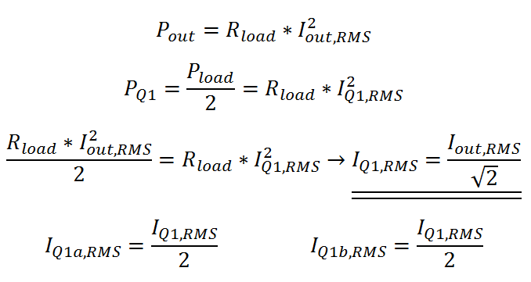
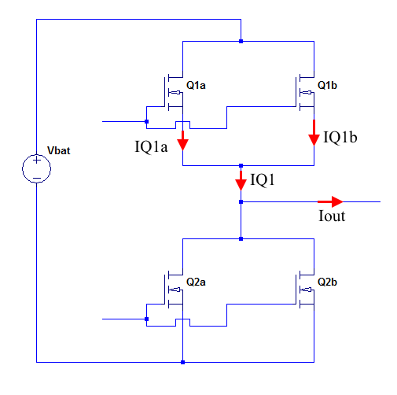
MOSFET minimum rating
Current to the Motor
Sinus peak | 300 | A
Current RMS | 212,1320344 | A, RMS
MOSFET max rating
Drain current in two MOSFET combined, RMS | 150 | A,RMS
Drain current in one MOSFET, RMS | 75 | A, RMS
Peak current in MOSFET | 150 | A
Vbat | 52,8 | V
Vds max rating | 100 | V

Slide 3
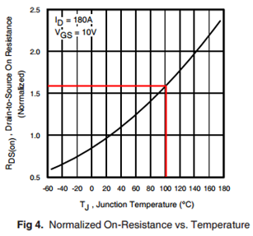

Conduction loss
Conduction loss
Tempurtur junction (Tj) | 100 | °C
Rds(on) faktor | 1,644
Rds(on) Typ. | 2,00E-03 | Ω
Rds(on) | 3,29E-03 | Ω
Pcon,Loss | 18,497 | W
Drain current in one MOSFET, RMS | 75 | A, RMS

Slide 4
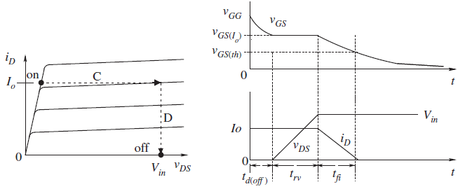
Switching loss –
Defining the on and off time
Based on assumptions
What is need to be defined?

Slide 5
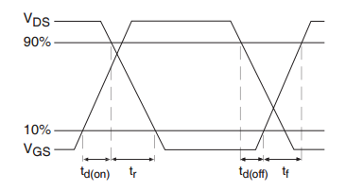
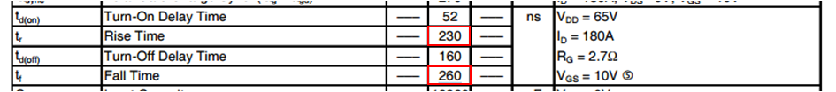
Switching loss –
Defining the on and off time
Rise and fall time of Vds

Slide 6
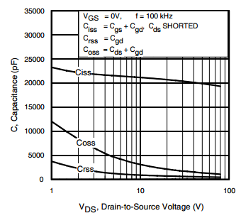
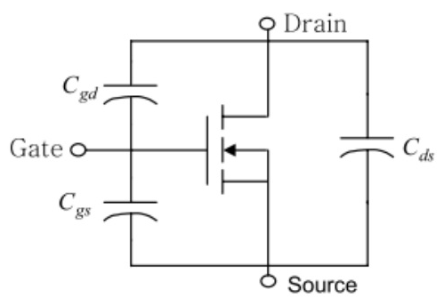

Switching loss –
Defining the on and off time
The fall time of the Id current
Assuming that Cgs is the same for on and off time. And it is equeal to Ciss at 50V
Cgs | 2,00E-08 | F

Slide 7
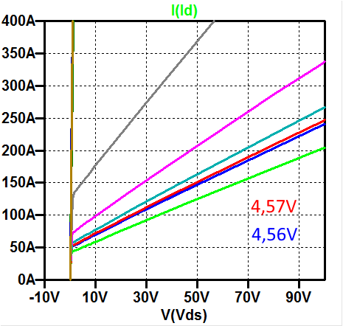
Switching loss –
Defining the on and off time
The Vgs voltage that makes Id=150A and Vds=52V

Slide 8
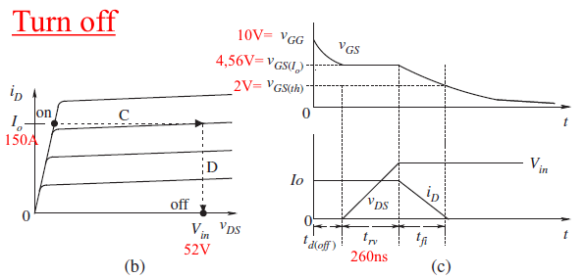


Switching loss –
Finding the off loss
Fsw = 20kHz
I gate off | 1,15 | A
Vgs(Io) | 4,56 | V
Vg th | 2 | V
tfi | 4,452E-08 | s
Time total | 3,045E-07 | s
Poff loss | 24,12 | W

Slide 9
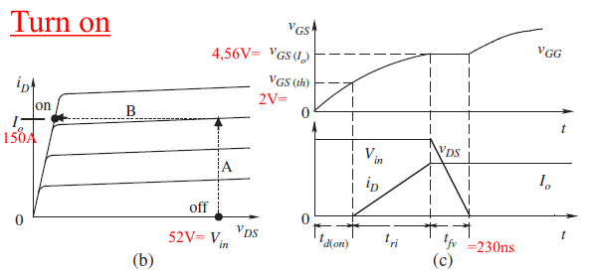

Switching loss –
Finding the on loss
Fsw = 20kHz
I gate off | 0,85 | A
Vgs(Io) | 4,56 | V
Vg th | 2 | V
tri | 8,024E-08 | s
Time total | 3,10E-07 | s
Poff loss | 24,571 | W

Slide 10
Total loss in one MOSFET
Conduction loss
Tempurtur junction (Tj) | 100 | °C
Rds(on) faktor | 1,644
Rds(on) Typ. | 2,00E-03 | Ω
Rds(on) | 3,29E-03 | Ω
Pcon,Loss | 18,497 | W
Switching loss
Switching frequence | 20000 | Hz
Total sw loss | 48,689 | W
Total Loss in one MOSFET
P loss, total | 67,186 | W

Slide 11
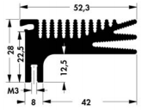
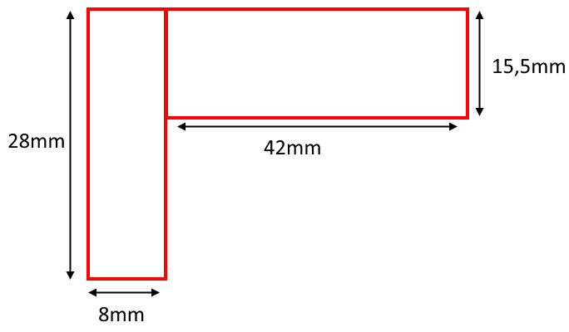

Thermal capacitor of heat sink
Thermal capacitor
Area | 8,75E-04 | m^2
Length | 8,40E-02 | m
Volume | 7,35E-05 | m^3
Correction factor of the volume | 2
Real volume | 3,68E-05 | m^3
Density | 2700 | Kg/m^3
Mass | 0,099225 | Kg
c alu | 900 | J/(°C*kg)
Thermal capacitor (Cs) | 89,3025 | J/°C

Slide 12
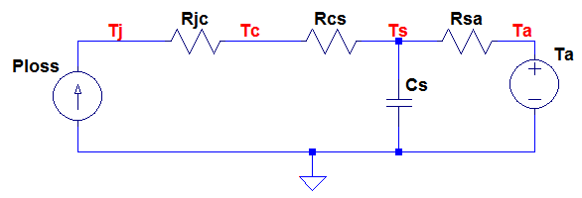
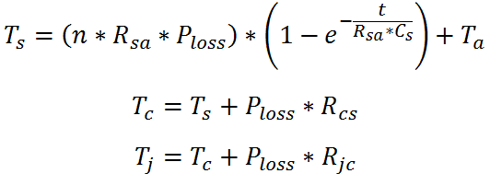
Max current step – 5s
The 5 seconds is from other calculations
Tempurtur MOSFET
Ta | 25 | °C
Time for max power | 5 | s
number of MOSFET on heat sink (n) | 1
Ts | 28,720 | °C
Tc | 44,844 | °C
Tj | 64,328 | °C

Slide 13
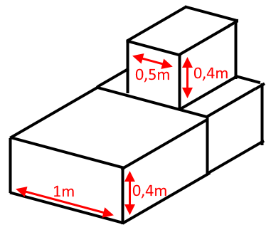
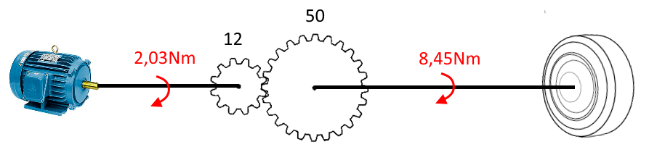
Current in max speed
Only wind resistance acts as load
Area of air drag | 0,6 | m^2
dimension number (C) | 0,804
Air density | 1,3 | kg/m^2
Max speed | 50 | km/t
Max speed | 13,89 | m/s
Air drag force | 60,49 | N
Torque on wheel | 8,45 | Nm
Gear ratio | 0,24
Torque from motor | 2,03 | Nm
Torque phas peak current rario
Max torque | 38 | Nm
Max phas peak current | 300 | A peak
Kt | 0,12667 | Nm/A
Phase current
Peak | 16,01 | A peak
RMS current | 11,32 | A RMS

Slide 14
Max speed power loss
Current from continuously max speed
From phase RMS | 11,321 | A RMS
Current in the two MOSFET | 8,005 | A RMS
Current in one MOSFET | 4,003 | A RMS
Conduction loss from continuously max speed
Pcon, max speed | 0,052682095 | W
Switching loss from continuously max speed
Because it is too difficult to calculate the Switching loss in max speed, it will be asumed that the loss is 5W
Psw, max speed | 5 | W
Total Loss in one MOSFET from max speed
P loss, total | 5,052682095 | W

Slide 15
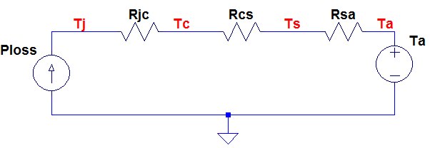
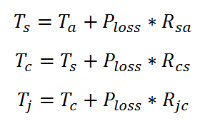
Nominal temperature
Norminal power loss in one MOSFET
Procent Time there is:
Max current | 33,33 | %
Max speed | 33,33 | %
Down accelaration | 33,34 | %
In down accelaration there is no power loss
The norminal power loss is therefore; | 24,07710456 | W
Tempurtur due to norminal power loss
Ts | 85,19276141 | °C
Tc | 90,9712665 | °C
Tj | 97,95362683 | °C

Slide 16
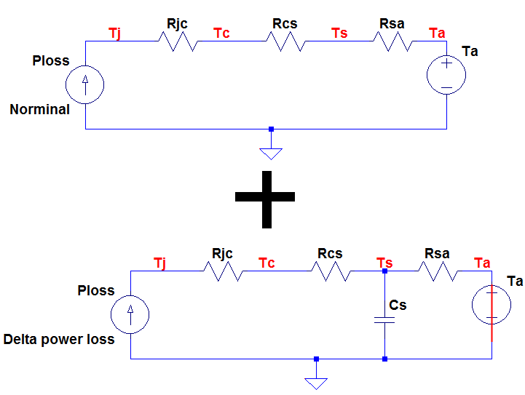
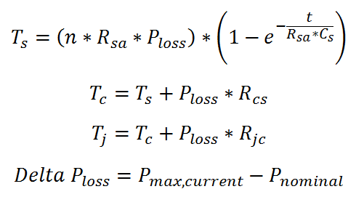
Max temperature
Two system

Slide 17
Max tempurtur
Tempurtur MOSFET delta
Delta power loss | 43,109 | W
Ts | 0,961 | °C
Tc | 11,307 | °C
Tj | 23,809 | °C
Tempurtur in one MOSFET
Ts | 86,154 | °C
Tc | 102,2785 | °C
Tj | 121,7624 | °C

